Slide 1

Module 0
Python Programming
Notes:
Guidelines
Use section headers to chunk content in your presentation.
Use the same style of section header throughout your presentation.
Keep your title to no more than 2 lines.

Slide 2
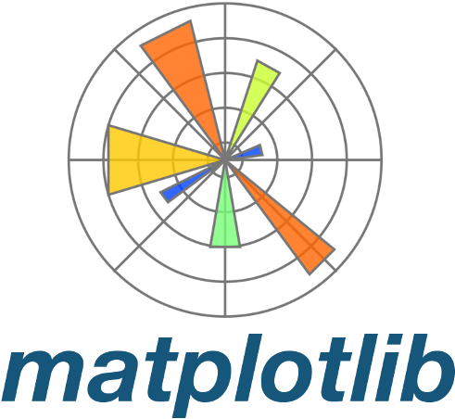

Python Basics
Notes:
Guidelines
Use a title slide at the beginning of your presentation. There are 9 variations of title slides to choose from.
If you will have a series of slideshows, we recommend using the same style of title slide for each presentation.
Keep your title to no more than 2 lines.
Do not change the font style or font size of the title or subtitle.

Slide 3
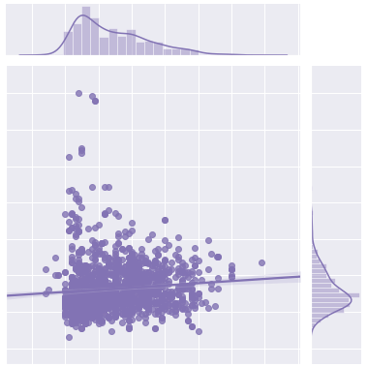
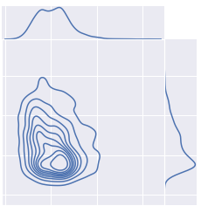
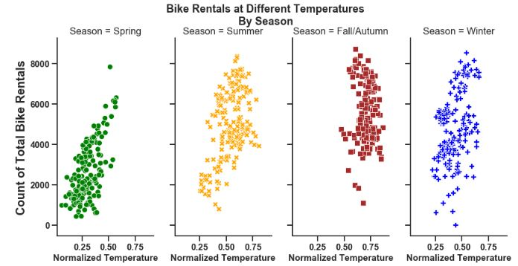
Matplotlib and Seaborn
Main modules generate visualizations (histograms, scatterplots,…)
Matplotlib is comprehensive library
Import Convention: import matplotlib.pyplot as plt
Seaborn is built on top of Matplotlib
Provides more aesthetic plots.
Easier to work with Pandas DataFrames
Import Convention: import seaborn as sns

Slide 4
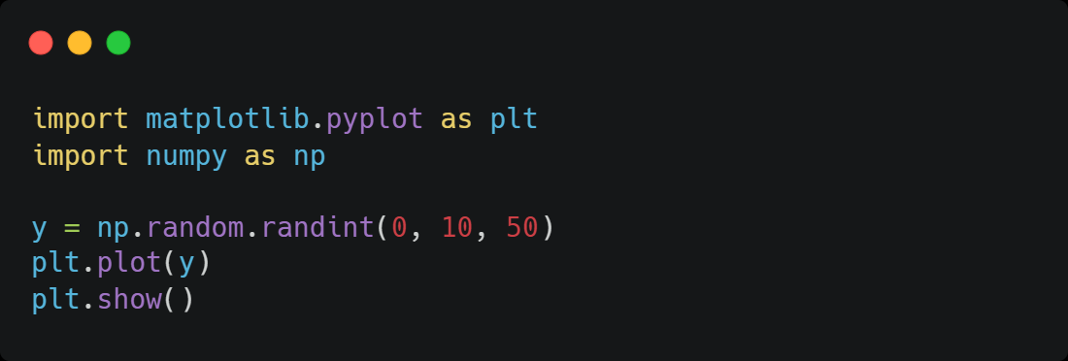
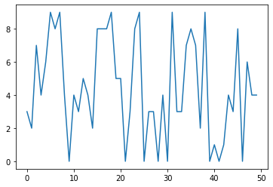
Line Plots
Displays data along a number line

Slide 5
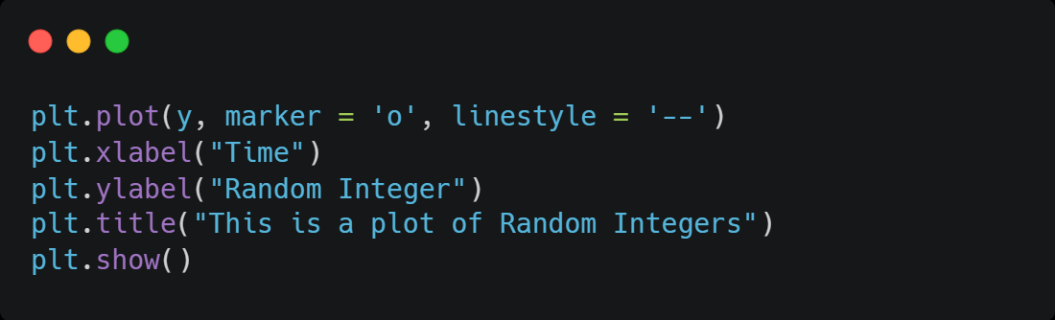
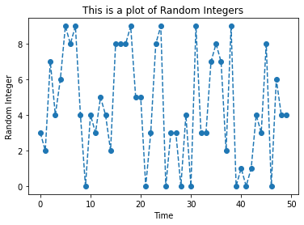
Line Plots
Matplotlib options

Slide 6
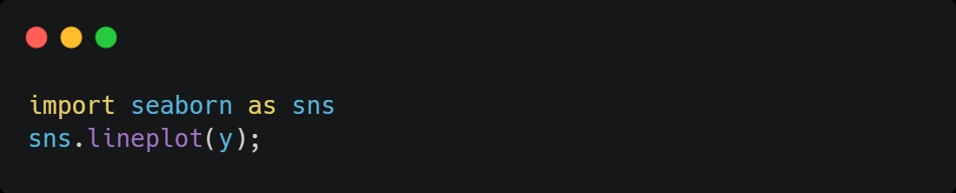
Line Plots
Seaborn presents similar visualizations

Slide 7
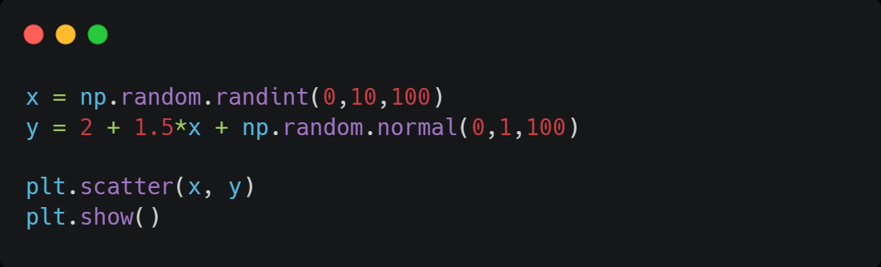
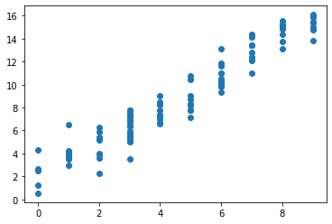
Scatter Plots
Shows the relationship between two sets of data

Slide 8
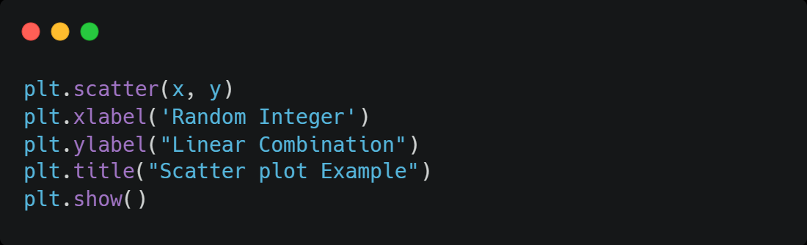
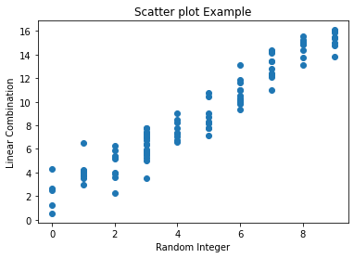
Scatter Plots
We can include other options

Slide 9
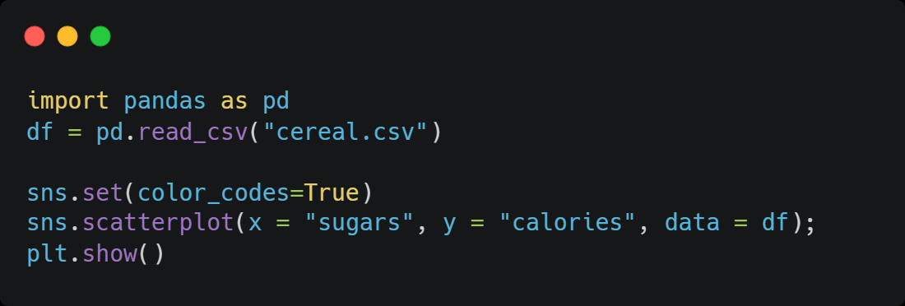
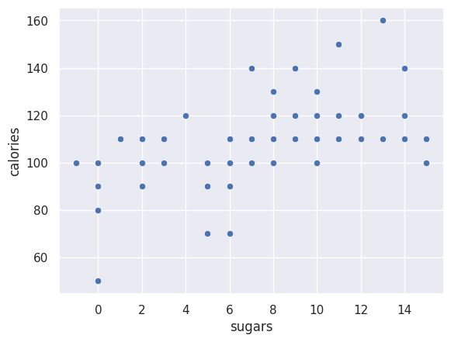
Scatter Plots
Seaborn is useful when working with data frames

Slide 10
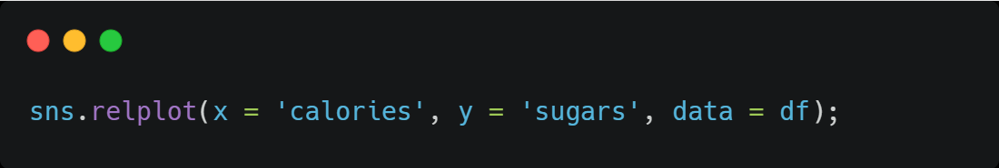
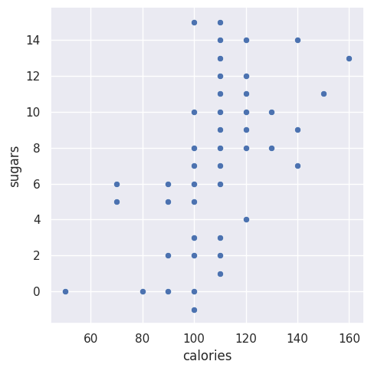
Scatter Plots
Seaborn is useful when working with data frames

Slide 11
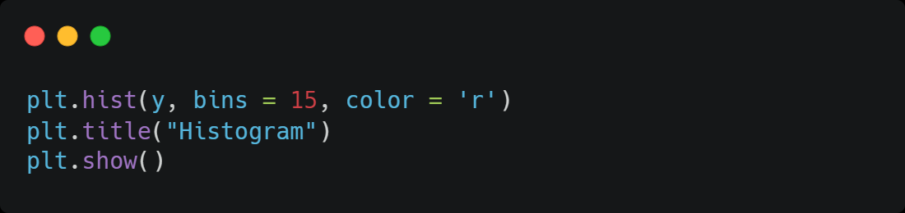
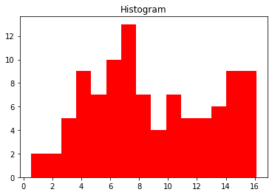
Histograms
Provide a visual representation of the distribution of the data

Slide 12
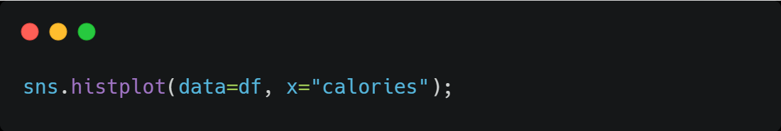
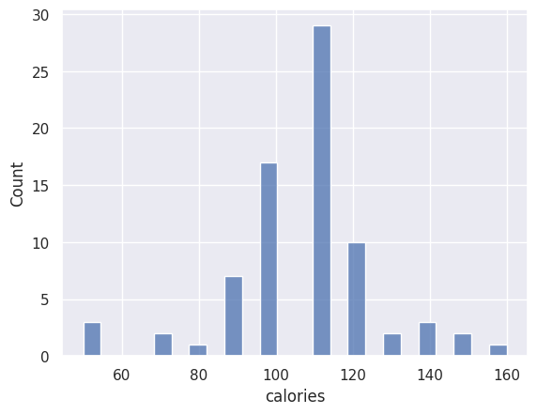
Histograms
Seaborn provides implementation of histograms

Slide 13
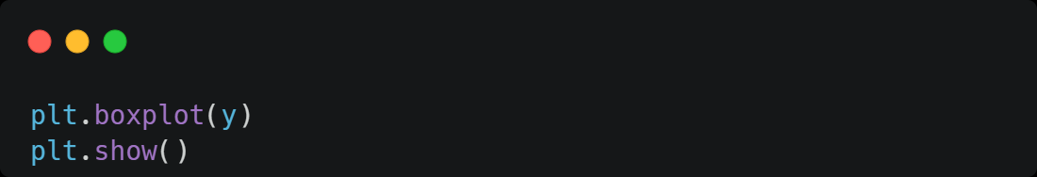
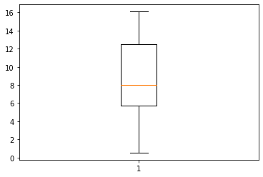
Other Visualizations
Boxplots

Slide 14
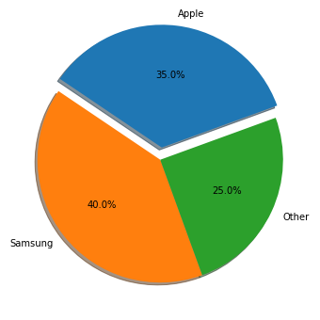
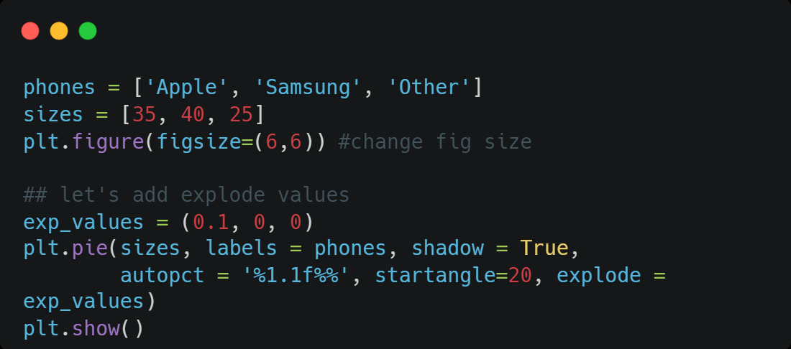
Other Visualizations
Pie Charts

Slide 15
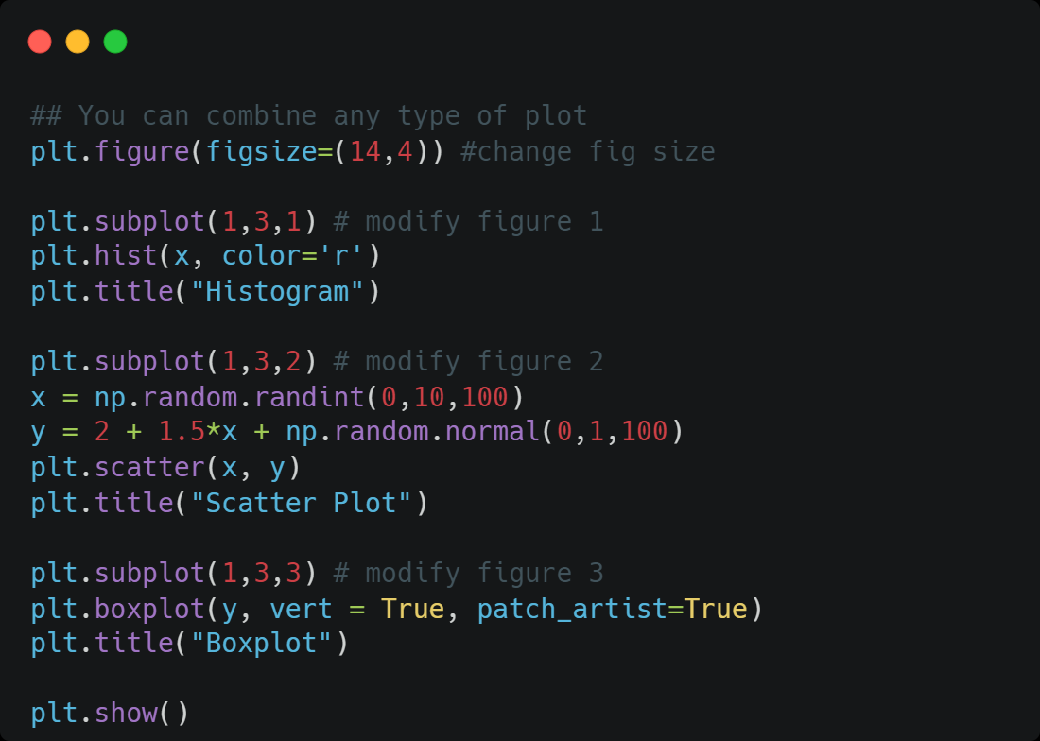
Other Visualizations
Subplots

Slide 16
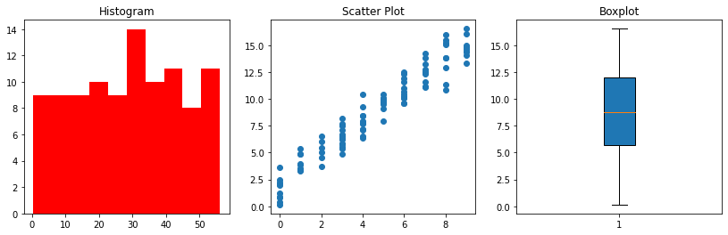
Other Visualizations
Subplots

